Slide 1
Geometric , Poisson and Uniform Distributions

Slide 2
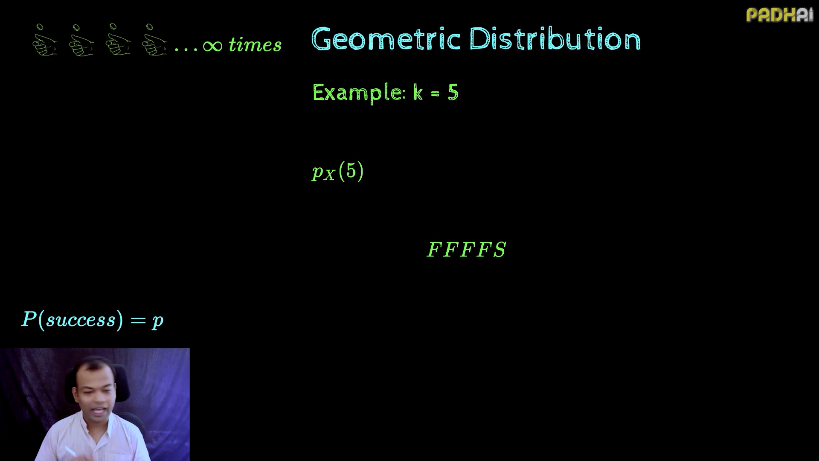

Slide 3
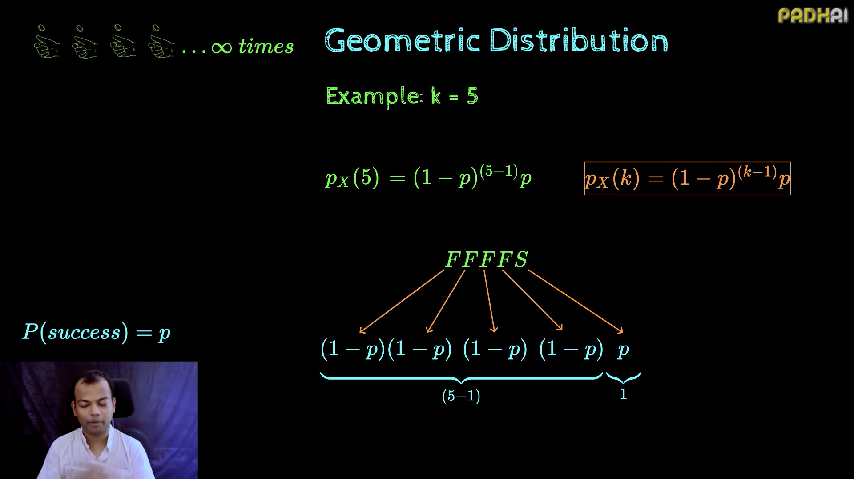

Slide 4
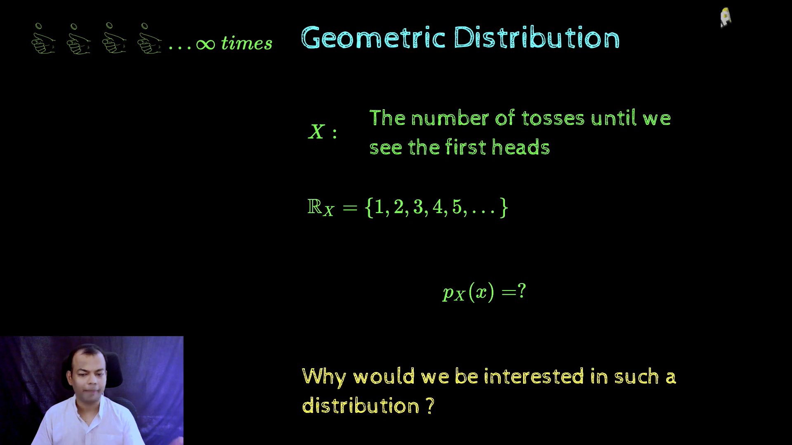

Slide 5
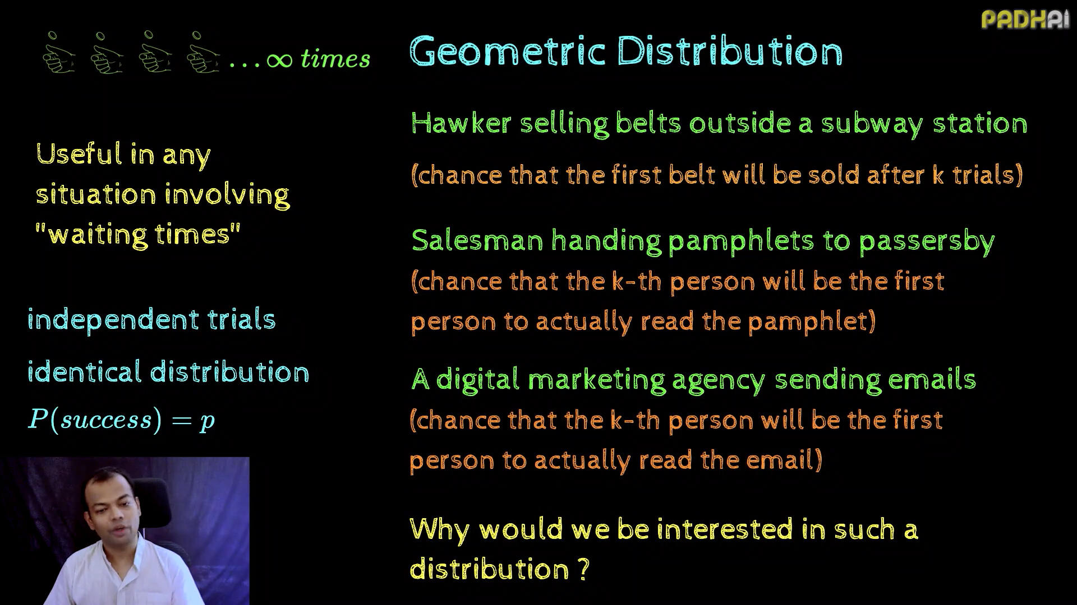

Slide 6
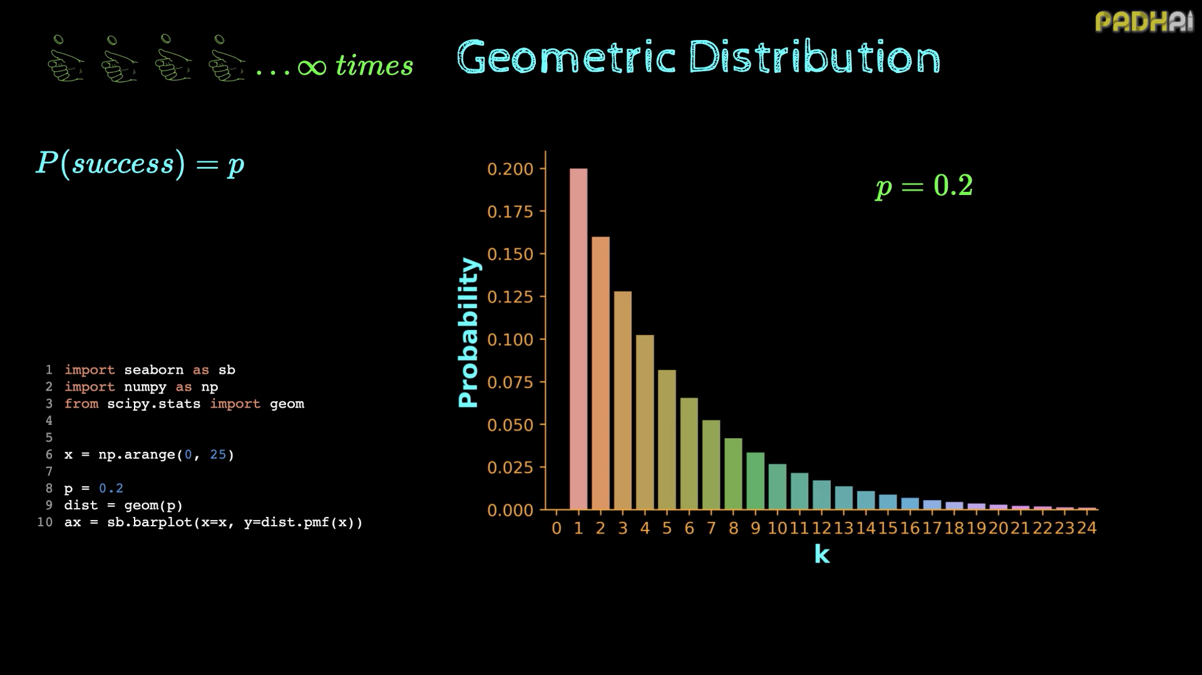

Slide 7
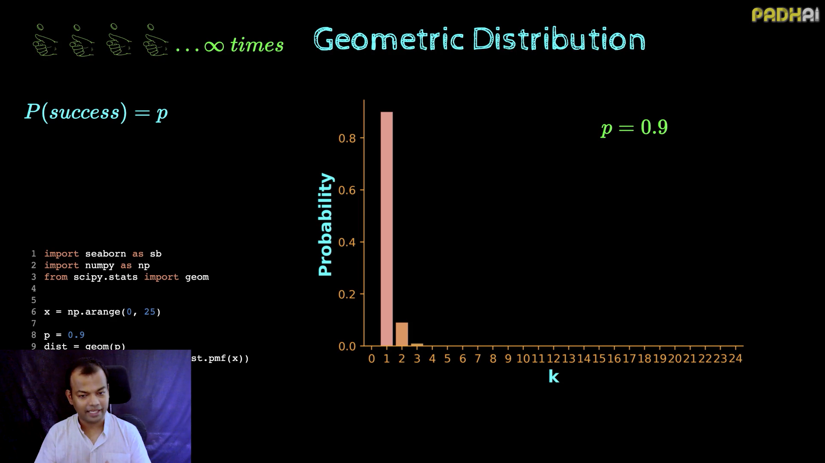

Slide 8
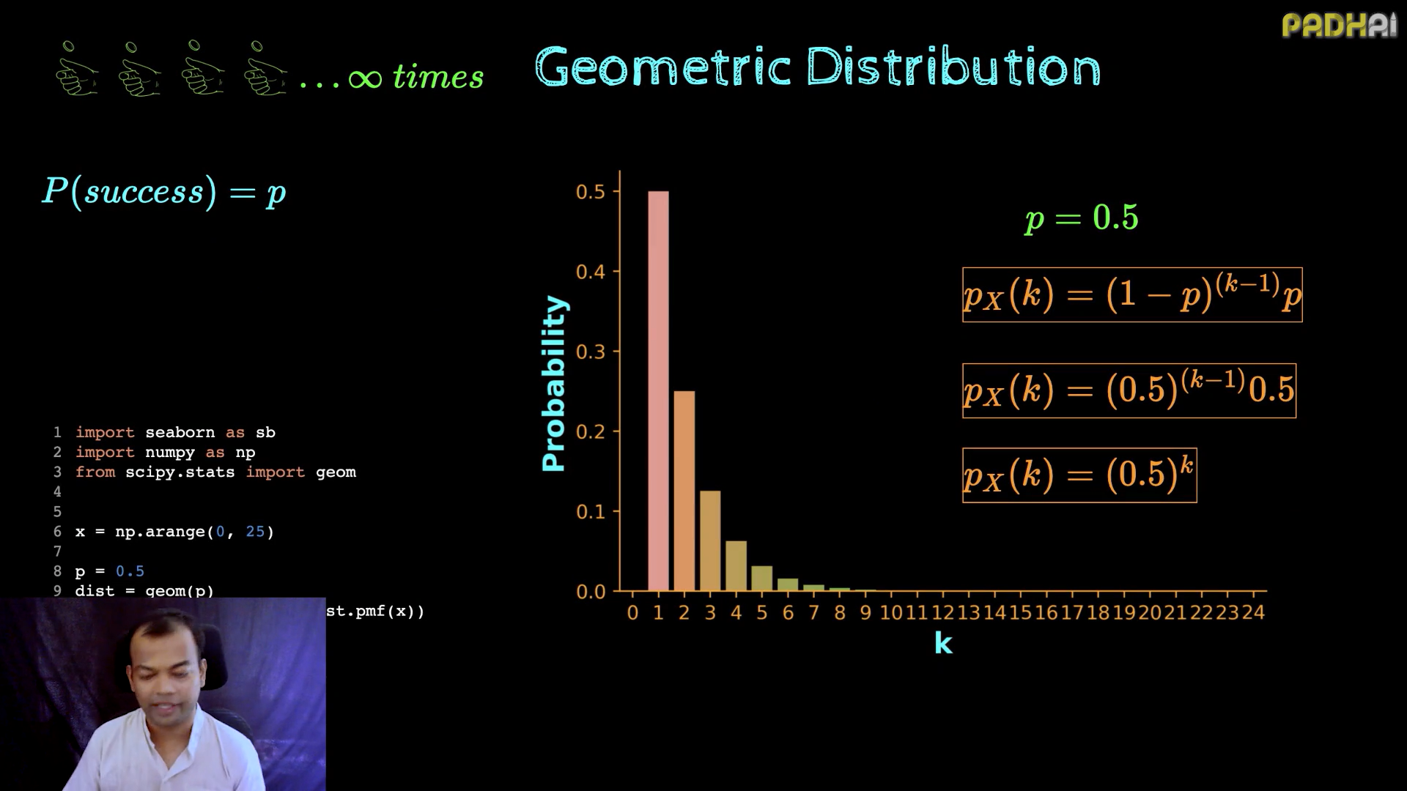

Slide 9
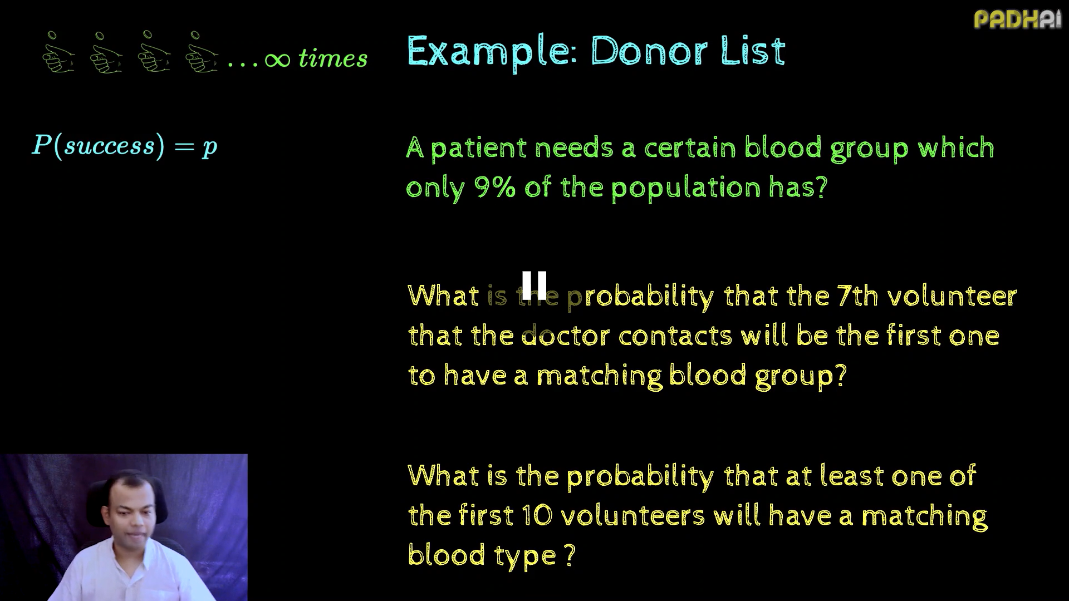

Slide 10
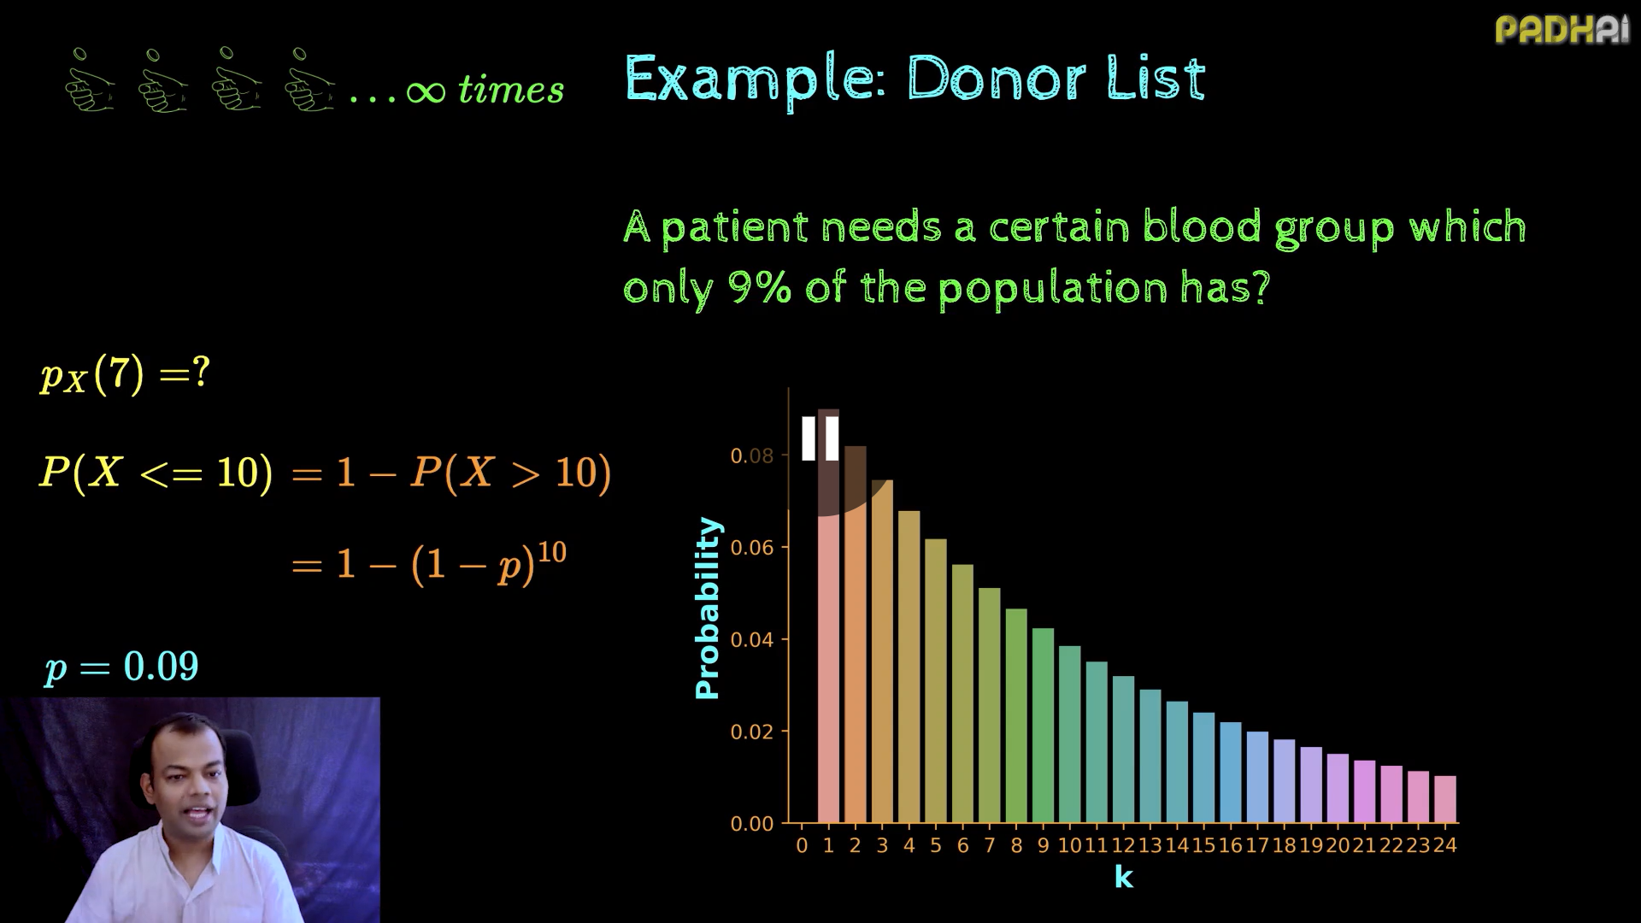

Slide 11
Online Advertising (Bernoulli)
Scenario: Whether a user clicks on an online ad or not.
Outcomes:
Success: The user clicks on the ad.
Failure: The user does not click on the ad.
Use Case: Understanding click-through rates for digital marketing campaigns.
Online Advertising Campaigns (Binomial)
Scenario: Out of 1,000 users who see an ad, how many will click on it?
Key Features:
Each user sees the ad (independent trials).
Success: The user clicks on the ad.
Failure: The user does not click on the ad.
Use Case: Estimating the click-through rate for a campaign.
Online Advertising (Geometric)
Scenario: Tracking how many ads are displayed to a user before they click on one.
Outcomes:
Success: The user clicks on the ad.
Failure: The user does not click on the ad.
Use Case: Determining how many ad impressions are needed before a click occurs to optimize ad placements and budgets.

Slide 12
Quality Control in Manufacturing (Bernoulli)
Scenario: Inspecting whether a product meets quality standards.
Outcomes:
Success: The product passes the quality check.
Failure: The product fails the quality check.
Use Case: Estimating defect rates in production.
Quality Control in Manufacturing (Binomial)
Scenario: Out of a batch of 100 products, how many pass quality control?
Key Features:
Each product is inspected (independent trials).
Success: The product passes quality control.
Failure: The product fails quality control.
Use Case: Determining the proportion of defective products in a batch.
Quality Control (Geometric)
Scenario: Inspecting items on a production line to find the first defective item.
Outcomes:
Success: A defective item is found.
Failure: The item is not defective.
Use Case: Estimating how many items need to be inspected before encountering the first defective one to assess production quality and reduce defects.

Slide 13
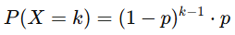
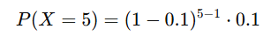
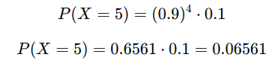
Problem 1: Online Advertising
Scenario: An ad has a 10% probability of being clicked. How many ads are likely to be shown before the first click? Question 1: What is the probability that it takes exactly 5 ads before the first click? Question 2: What is the probability that it takes more than 5 ads to get the first click?
The PMF for a geometric distribution is:
p is the probability of success (click = 0.1 or 10%).
k is the number of trials until the first success.

Slide 14
Probability Distributions
A probability distribution is just a way of showing how likely different things are to happen. It helps scientists, engineers, and businesses make smarter predictions based on data. So, next time you play a game or check the weather, remember—you’re actually using probability distributions without even knowing it!
Imagine you are rolling a die. You know that the die has six sides, and each number (1 to 6) has an equal chance of appearing.
If you roll the die many times and keep track of how often each number appears, you’ll start seeing a pattern.
This pattern is what we call a probability distribution—it shows how likely different outcomes are.
Bernoulli distributions are sometimes confused with Binomial distributions. While related, they are distinct:
A Bernoulli distribution models a single trial with two possible outcomes.
A binomial distribution models the number of successes in a fixed number of independent Bernoulli trials.
Binomial distribution
The binomial distribution is useful when you're dealing with multiple trials as opposed to a single event. This alternative is often considered when you're interested in the number of successes across several attempts rather than just one outcome.
Geometric distribution
The geometric distribution comes into play when you're interested in how many attempts it will take to achieve the first success. It's often applied in situations where the focus is on the waiting time or number of attempts before success happens.

Slide 15
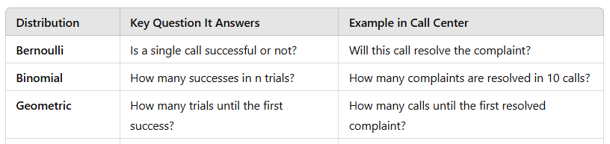

Slide 16
Poisson Distribution
The Poisson distribution models the probability of a certain number of events happening in a fixed time interval.
Website Traffic
An e-commerce website receives 12 visitors per minute on average.
We model the probability of receiving k visitors in one minute.
Product Defects in a Factory A factory produces 1000 items per hour, and on average, 3 defective items are found.
We model the probability of finding k defective items in an hour.
Calls Received at a Help Desk A customer support center gets 8 calls per hour on average.
We model the probability of receiving k calls in an hour.
1. How likely it is to get a certain number of visitors per minute.
2. Predicts how many defective products will be found in an hour.
3. Models the probability of receiving different numbers of calls in an hour.

Slide 17
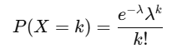
The Poisson distribution is used to model the number of events occurring in a fixed interval of time or space when these events occur independently and at a constant average rate.
Probability Mass Function (PMF) of Poisson Distribution
The Probability Mass Function (PMF) of a Poisson-distributed random variable X is given by:
where:
k = number of occurrences (discrete values like 0, 1, 2, …)
λ = average rate (mean number of occurrences in the interval)
e = Euler’s number (≈ 2.71828)

Slide 18
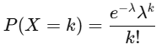
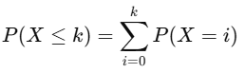
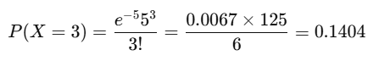
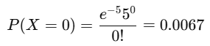
Suppose a call center receives an average of 5 calls per hour.
What is the probability that exactly 3 calls arrive in an hour?
What is the probability that atmost 3 calls arrive in an hour?
The Cumulative Distribution Function (CDF) gives the probability that the Poisson random variable takes a value less than or equal to a given value k:
PMF:
CDF:
Using λ=5 and k=3:
the probability of receiving exactly 3 calls in an hour is 0.1404 (or 14.04%)
the probability of receiving at most 3 calls in an hour is 0.265 (or 26.5%).

Slide 19
Scenario: A single customer call is analyzed to determine whether the issue is resolved or not.
Success (1): The issue is resolved.
Failure (0): The issue remains unresolved.
Use Case: Measuring the efficiency of customer support for one call.
👉 Example Question: What is the probability that a randomly selected customer call resolves the complaint?
Scenario: Over the course of 10 calls, the call center wants to know how many issues are successfully resolved.
Number of trials (n): 10 customer calls
Success probability (p): Probability of resolving a complaint in a call (say 70%)
Use Case: Estimating the probability of resolving a certain number of complaints in 10 calls.
👉 Example Question: What is the probability that exactly 7 out of 10 calls resolve the complaints?
Scenario: The call center wants to determine how many calls it takes to resolve the first customer complaint.
Success: A complaint is resolved.
Failure: The complaint remains unresolved.
Use Case: Measuring the probability of resolving the first complaint after k calls.
👉 Example Question: What is the probability that the first resolved complaint happens on the 4th call?
Scenario: The call center receives an average of 6 complaints per hour. They want to know how likely it is that they receive exactly 10 complaints in the next hour.
Average rate (λ): 6 complaints per hour
Random variable (X): Number of complaints received in an hour
Use Case: Estimating the probability of receiving a certain number of complaints per hour.
👉 Example Question: What is the probability that exactly 10 complaints are received in the next hour?

Slide 20
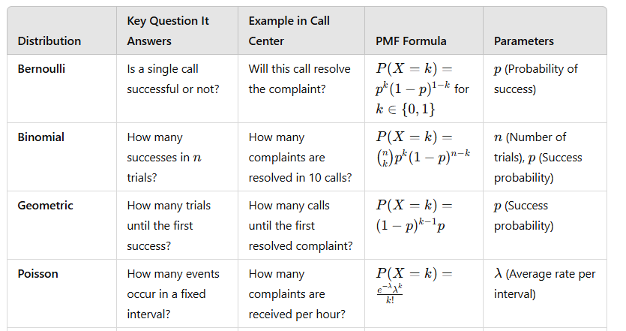

Slide 21
PMF and CDF Important in Real Life?
Call Centers – Estimating the probability of receiving a certain number of calls per hour to optimize staffing.
Traffic Flow – Predicting the number of cars passing through a toll booth per minute.
Retail Demand – Estimating the probability of receiving a certain number of customers in a shop.
Server Requests – Estimating the probability of a web server receiving a certain number of hits per second.

Slide 22
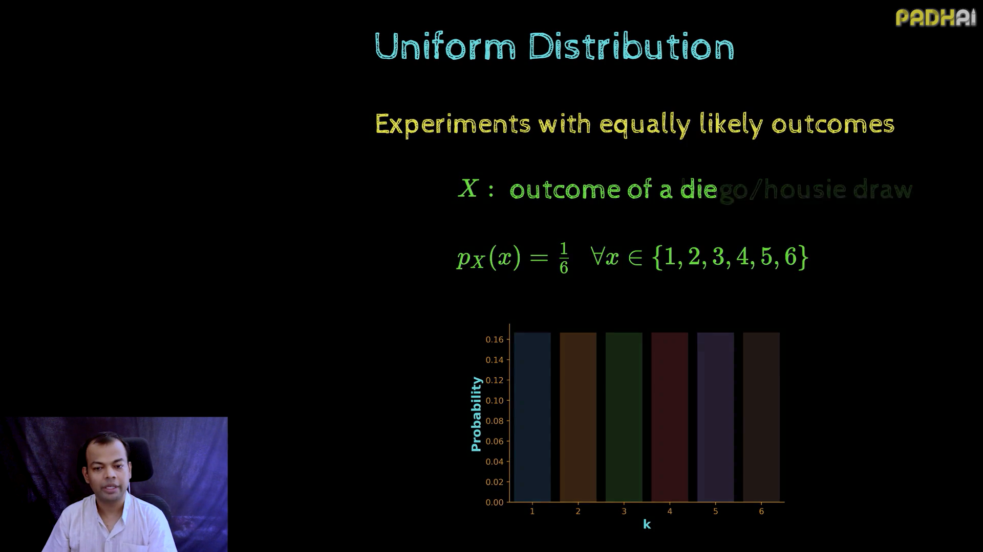

Slide 23
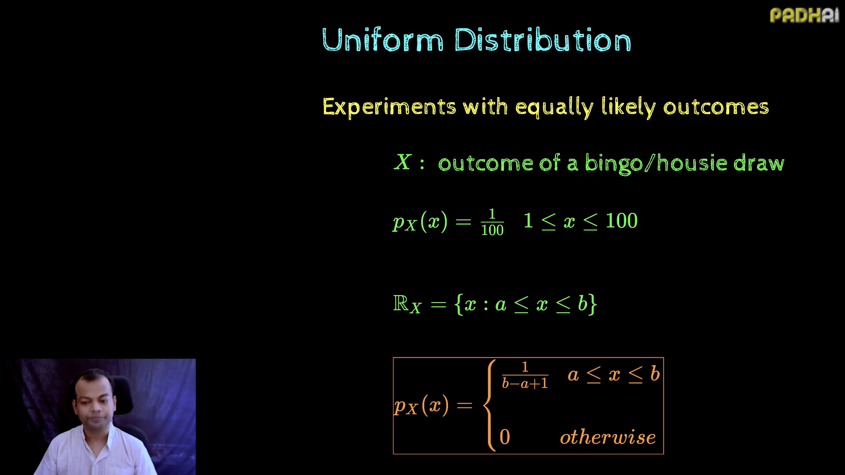

Slide 24
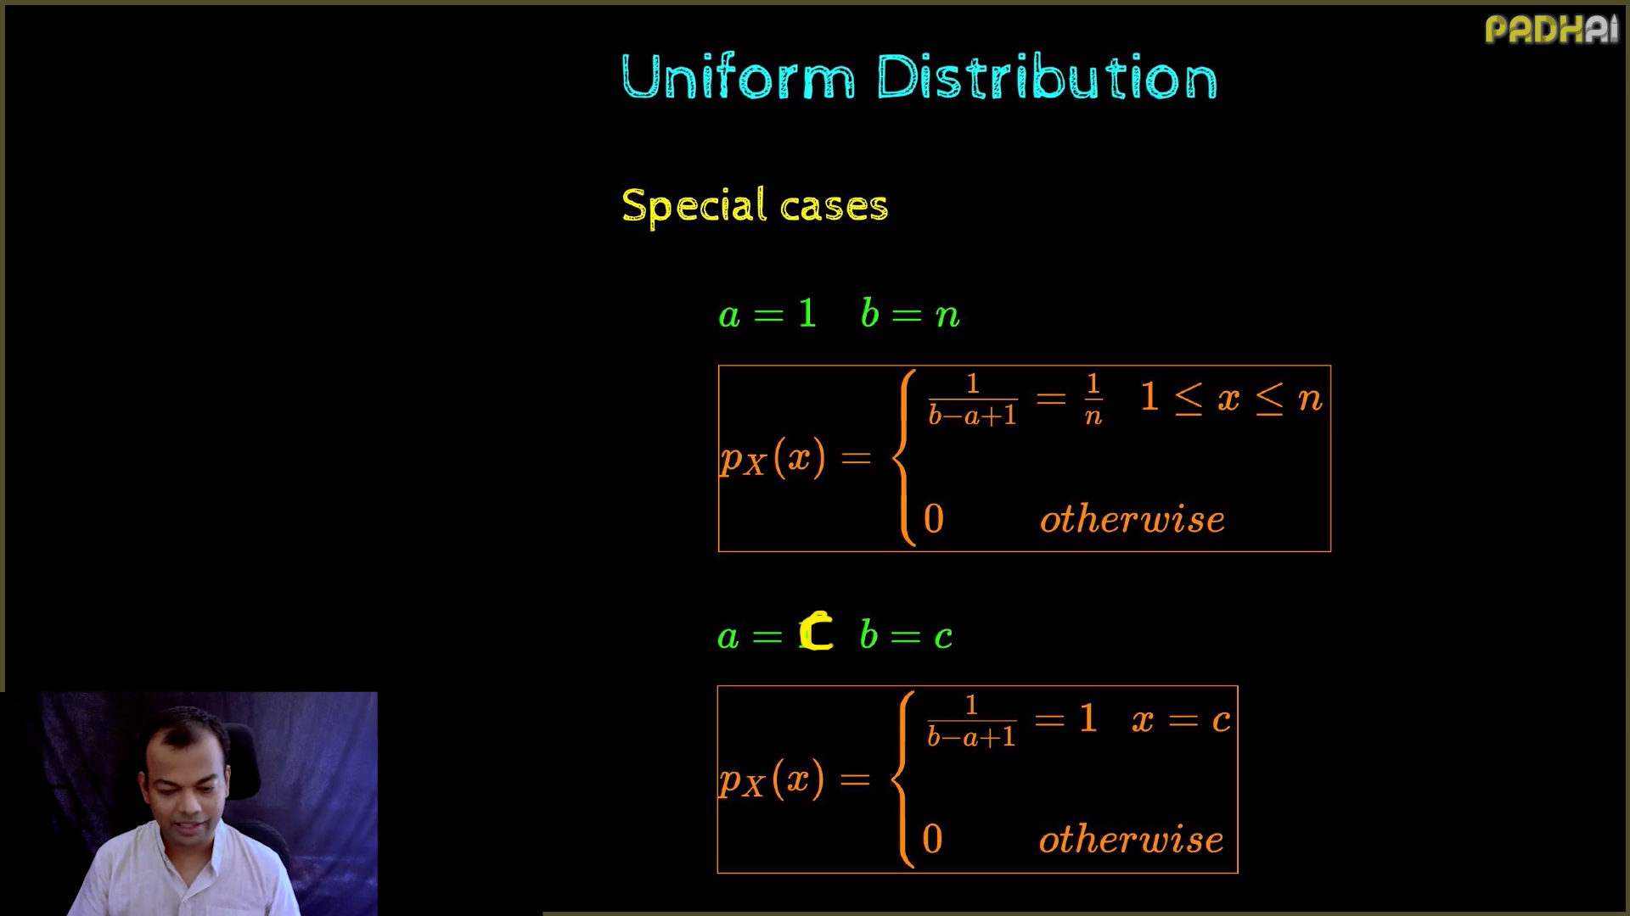

Slide 25
